Slide 1
Music Playlist Manager
Team Detail:
raunak raj , 41
swayam raj , 54
akshar adgale , 02
prajwal tushark ,56

Slide 2
Introduction
• Brief Overview:
A Music Playlist Manager that uses efficient data structures (mainly Doubly Linked List) to store, organize, and navigate songs. It supports dynamic playlist creation, fast insertion/deletion, and smooth next/previous playback like real music apps.
• Problem Addressed:
Users face difficulty managing large music collections due to slow navigation, inefficient insertion/deletion, and poor organization when using static structures like arrays.
• Importance of the Problem:
Efficient playlist handling is essential for modern music applications. Poor data management leads to lag, bad user experience, and scalability issues as the music library grows.
• Objective of the Project:
To design a fast, dynamic, and user-friendly playlist system using appropriate DSAs, enabling quick traversal, easy song management, instant search, and real-world application of data structures.

Slide 3
Problem Statement
• Issue/Situation Being Solved:
Managing large music collections becomes inefficient with static data structures. Users struggle with slow navigation, difficulty adding/removing songs, and poor playlist organization. The project solves these issues by using dynamic and efficient data structures.
• Constraints & Assumptions:
Playlist size can grow or shrink at any time.
Operations must remain fast (insert, delete, next/previous).
Memory usage should remain efficient.
Assumes songs are stored as objects with attributes (title, artist, duration).
No external database; data is handled in-memory using DSAs.
• Target Users / Application Area:
Music app developers
Students learning data structures
Users managing large personal music libraries
Applications like media players, streaming services, playlist editors

Slide 4
System Requirements / Tools Used
• Programming Language:
Python (chosen for implementing linked lists, queues, and other DSAs effectively)
• IDE / Software Tools:
Visual Studio Code
• Libraries Used:
The code fundamentally requires tkinter for the entire graphical user interface (GUI) and pygame for all audio playback (pygame.mixer.init(), pygame.mixer.music.load(), etc.).
• Hardware Requirements (if any):
Any basic computer with 2–4 GB RAM
No special hardware needed; runs entirely in-memory
Standard OS (Windows)

Slide 5
Data Structures Used
Doubly Linked List
Why chosen:
Supports efficient insertion, deletion, and smooth forward/backward navigation—perfect for playlist operations.
How used:
Acts as the main playlist structure where each node stores a song and pointers to the next and previous songs.
• Hash Map (Hash Table)
Why chosen:
Provides O(1) average-time search, ideal for quickly locating songs in large playlists.
How used:
Stores song titles/IDs as keys and pointers to their corresponding linked list nodes as values, enabling instant song lookup and fast jumps within the playlist.

Slide 6
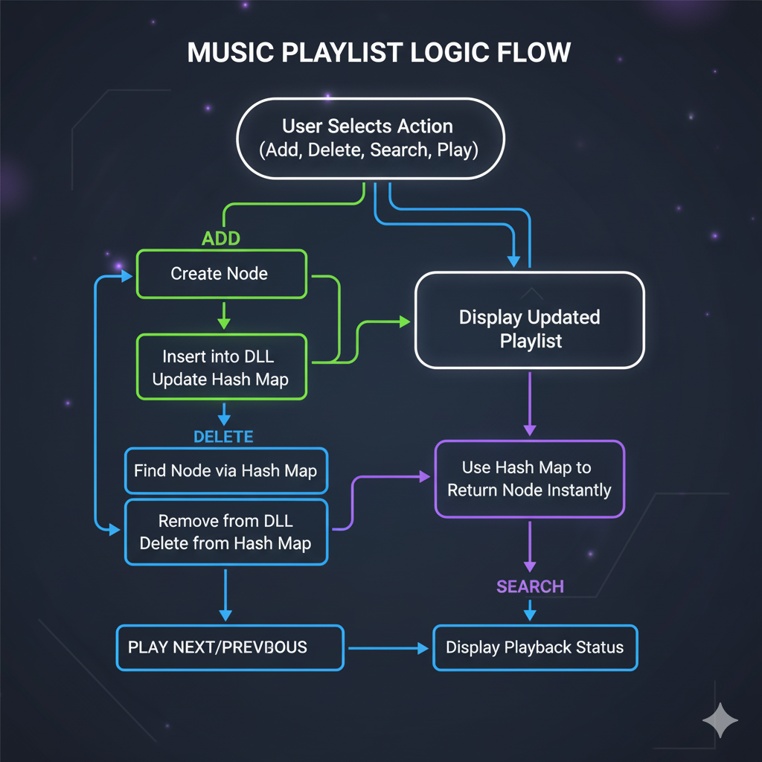
Algorithm Design
Key Algorithms Used
Insert Song (DLL): Create a new node and adjust previous/next pointers.
Delete Song (DLL): Relink surrounding nodes and free the target node.
Search Song (Hash Map): Direct lookup using song title/ID as key.
Play Next/Previous: Move to current->next or current->prev.
Jump to Song: Fetch node from Hash Map and set as current.
Stack (self.history):To store a history of played songs, allowing the user to go backward. This is a LIFO (Last-In, First-Out) behavior.
Time & Space Complexity (Brief)
Insertion (DLL): O(1)
Deletion (DLL): O(1)
Search (Hash Map): O(1) average
Traversal (DLL): O(n)
Space: O(n) for DLL + O(n) for Hash Map → O(n) total

Slide 7
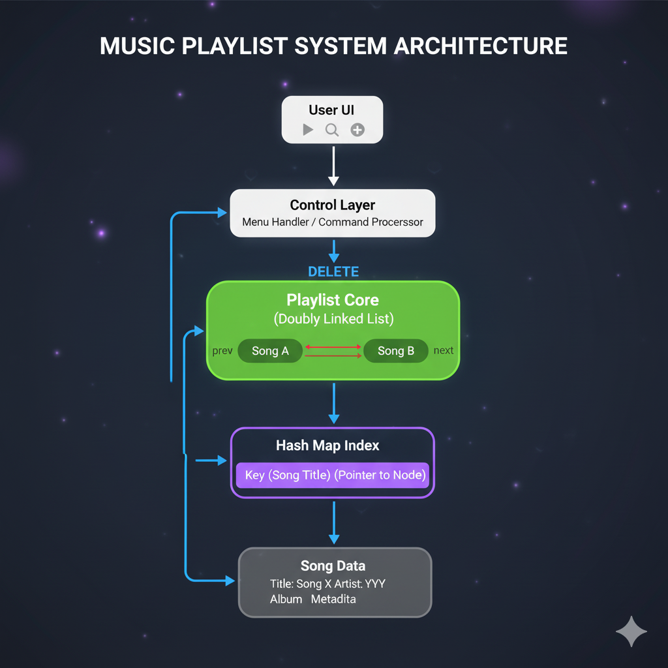
System Architecture / Workflow
User selects action (Add, Delete, Search, Play).
Control Layer interprets the command.
For Add/Delete:
  Updates the Doubly Linked List (physical playlist).
  Updates the Hash Map (index for fast lookup).
For Search:
  Hash Map instantly returns the song node.
For Play:
  Use Stack for playing.
UI displays updated playlist or playback details.

Slide 8
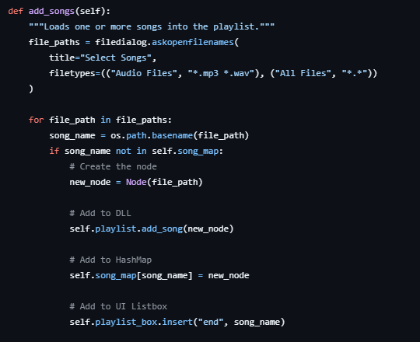
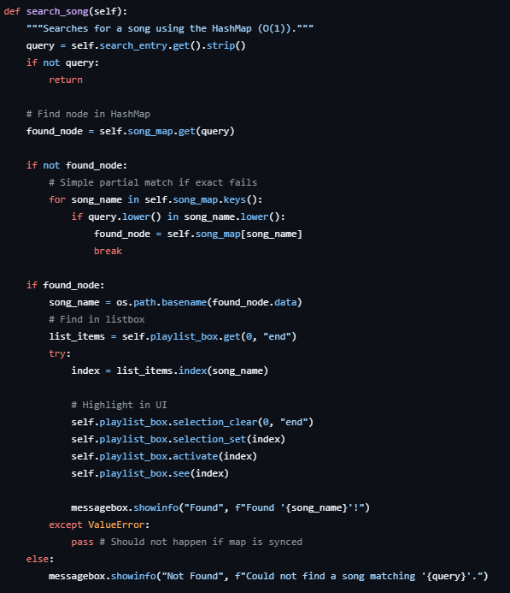
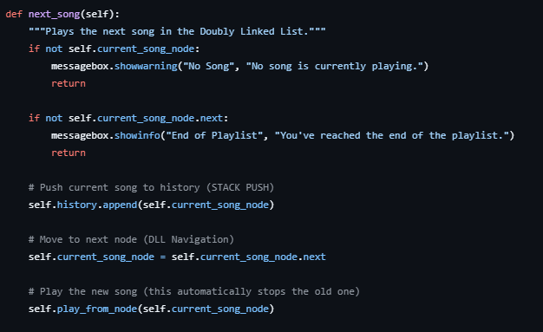
Implementation
🔹 Core Structures (DLL + Hash Map)
🔹 Search(Fetching from node)
🔹 Play Next / Previous

Slide 9
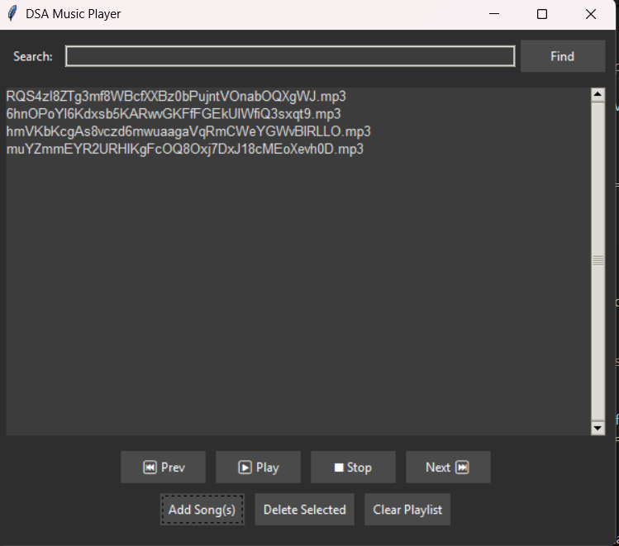
Demonstration

Slide 10
Results
✔ Outputs Generated
Successfully adds, deletes, searches, and displays songs.
Allows navigation using Next and Previous.
Maintains playlist order using Linked List + fast lookup using Hash Map.
Generates clear console messages and demo interactions.
✔ Features Achieved
Add / Remove Songs in O(1) using linked list + hash map combo.
Fast Search by song name using hash map.
Play Next / Previous using doubly linked navigation.
Efficient storage of playlist without duplicates.
Maintains current song pointer for smooth browsing.
⚠ Limitations
No persistent storage (playlist resets when program closes).
Limited error handling for invalid inputs

Slide 11
Conclusion
📌 Summary of the Project
Developed a Music Playlist Manager using Python, Linked List, and Hash Map to efficiently store, navigate, and search songs. The system supports adding, removing, and browsing through a playlist in an organized way.
📌 What Was Achieved
Designed an efficient playlist structure using Doubly Linked List + Hash Map.
Implemented key features: Add, Delete, Search, Play Next, Play Previous.
Achieved O(1) search and smooth navigation between songs.
Built a clean, modular and optimized code structure.
📌 Learning Outcomes
Understood real-world use of Linked Lists for dynamic data management.
Learned how Hash Maps enhance speed by enabling instant lookups.
Practiced algorithm design, pointer manipulation, and complexity analysis.
Gained experience structuring a complete DSA-based Python project.

